Slide 1

MACHINE LEARNING IN MONEY LAUNDERING DETECTION USING CRYPTOCURRENCY DATA
PRESENTED BY GUIDED BY
S.Shoaib(22KH1A3340) D.Masthan Pasha ,M.Tech.,(ph.D)
C.Harinath(22KH1A3310) Assistant Professor Dept of CSE(AI&ML)
D.Vyshnavi(22KH1A3312)

Slide 2
CONTENTS
Abstract
Introduction
Objectives
Existing System
Disadvantages
Proposed System
Advantages
System Requirements
System Architecture
Modules
UML Diagrams
Test Cases
Output Screenshots
Conclusion
Future Enhancement

Slide 3
ABSTRACT
Money laundering is a major financial crime that hides illegal funds through complex transaction networks. This project uses machine learning techniques to analyze cryptocurrency transaction data and detect suspicious patterns. The system identifies unusual activities that may indicate money laundering using the XGBoost algorithm, which effectively handles complex data. It enables faster and more accurate detection of financial crimes while reducing false positives. The model achieves around 98% accuracy, improving the overall efficiency and reliability of the system.

Slide 4
INTRODUCTION
The growth of cryptocurrency has improved digital transactions but also increased financial crimes due to user anonymity. Traditional AML systems are inflexible and struggle to handle complex and evolving transaction patterns. Machine learning enables accurate detection by analyzing large-scale data and learning transaction behavior. It adapts to new laundering techniques, reduces false positives, and improves overall security and efficiency in cryptocurrency systems.

Slide 5
OBJECTIVIES
Detect suspicious wallets and transactions by analyzing unusual patterns, high-risk behavior, and abnormal fund movements.
Reduce AML false positives by improving accuracy and filtering out genuine transactions from risky ones.
Support regulators by providing transparent monitoring, reports, and compliance-ready transaction tracking.
Identify layered money laundering activities by tracing complex transaction chains across multiple wallets.

Slide 6
EXISTING SYSTEM
Existing money laundering detection systems mainly use traditional models like Support Vector Machines (SVM). These models analyze basic features such as transaction amount, frequency, and wallet activity, achieving around 90% accuracy on simple datasets and offering good computational efficiency. However, they struggle with complex, non-linear, and evolving transaction patterns. Advanced techniques like chaining and mixing are not effectively captured, leading to reduced real-world accuracy and higher false positives, making them less suitable for modern cryptocurrency environments.

Slide 7
DISADVANTAGES
High Computational Cost
High False Positive Rates
Higher Training Time for Large Datasets
Limited Scalability for Large Data

Slide 8
PROPOSED SYSTEM
The proposed system uses XGBoost, an advanced ensemble learning model, to detect money laundering in cryptocurrency transactions. It combines multiple decision trees to improve accuracy and handles complex, non-linear data effectively. The model reduces overfitting, processes large volumes of data efficiently, and adapts to new patterns through continuous learning. This results in higher detection accuracy and fewer false positives compared to traditional methods, making it suitable for modern cryptocurrency environments.

Slide 9
ADVANTAGES
High Accuracy
Reduce False Positives
Scalable for Larger Data
Handles Missing Data

Slide 10
SYSTEM REQUIREMENTS
Software Requirements
Windows / Linux OS
Python 3.8+
Flask Framework
NumPy, Pandas, Scikit-learn,
XGBoost
Hardware Requirements
Intel i5 or higher processor
8 GB RAM minimum
100 GB HDD/SSD
Internet connectivity

Slide 11
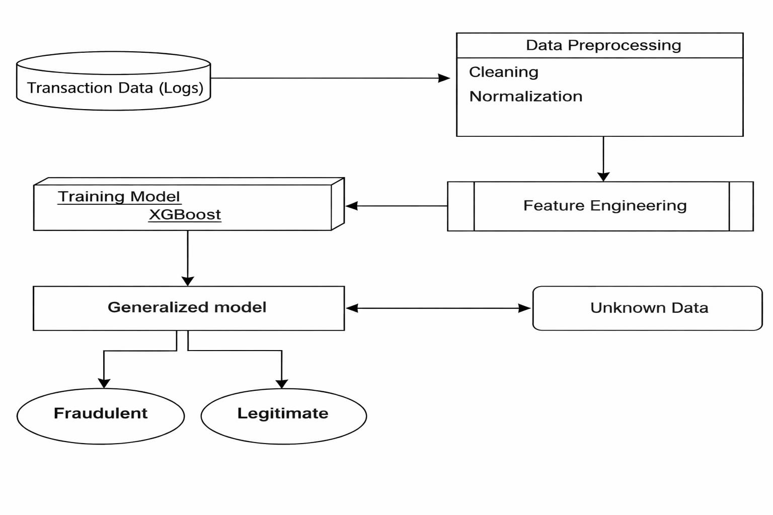
SYSTEM ARCHITECTURE

Slide 12
MODULES
Data Collection
Data Preprocessing Module
Feature Extraction Module
Model Training Module
Suspicious Transaction Detection Module

Slide 13
DATA COLLECTION MODULE
The Data Collection Module is the first stage of the system, where cryptocurrency transaction data is collected from various platforms. It includes details such as transaction IDs, wallet addresses, timestamps, transaction amounts, and block numbers. In this project, the dataset is obtained from Kaggle and contains 30,001 rows and 9 columns. The main objective is to gather reliable data for training machine learning models, which is then stored in formats like CSV files or databases for further processing.

Slide 14
DATA PREPROCESSING MODULE
After collecting the data, the Data Preprocessing Module is used to clean and organize it. The cryptocurrency transaction data from the Blockchain may contain missing values, duplicates, or irrelevant information.This module removes duplicates, handles missing values, and converts categorical data into numerical form. It also extracts useful features like transaction frequency and transaction volume.Finally, normalization or scaling is applied to improve model performance. This step is important because machine learning models need clean and structured data for accurate predictions.

Slide 15
FEATURE ENGINEERING
The Feature Extraction Module selects important information from preprocessed cryptocurrency data. Since not all data is useful, only meaningful features are chosen to help the model understand transaction behavior.Common features include transaction amount, frequency, number of wallet interactions, and average transaction value. It can also use network relationships between wallets to detect suspicious patterns.This module converts the data into a structured format that can be used by machine learning models.

Slide 16
MODEL TRAINING MODULE
The Model Training Module is where machine learning algorithms are trained using the prepared dataset. Algorithms like Random Forest, XGBoost, Logistic Regression, and Neural Networks are used to detect suspicious transactions.The data is split into training and testing sets. The model learns patterns from the training data and adjusts itself to reduce errors and improve accuracy.The main goal is to build a model that can accurately detect money laundering transactions.

Slide 17
SUSPICIOUS TRANSACTION DETECTION MODULE
The Suspicious Transaction Detection Module uses the trained model to analyze new cryptocurrency transaction data. It examines each transaction and predicts whether it is normal or suspicious based on learned patterns.If a transaction is flagged as suspicious, it may indicate possible money laundering activity. The system can also generate alerts for further investigation by analysts or authorities.This module helps organizations monitor large volumes of transactions efficiently, reduces manual effort, and improves the speed and accuracy of detecting illegal activities.

Slide 18
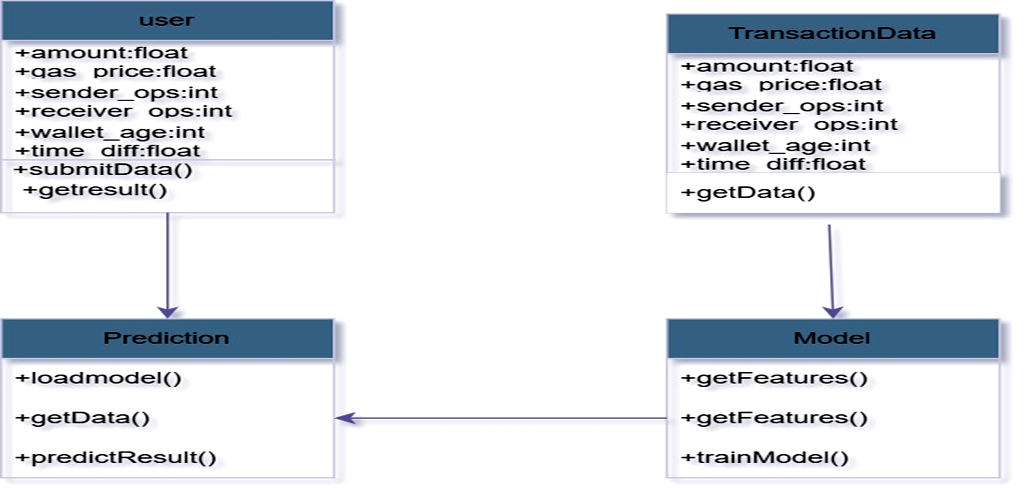
UML DIAGRAMS
CLASS DIAGRAM

Slide 19
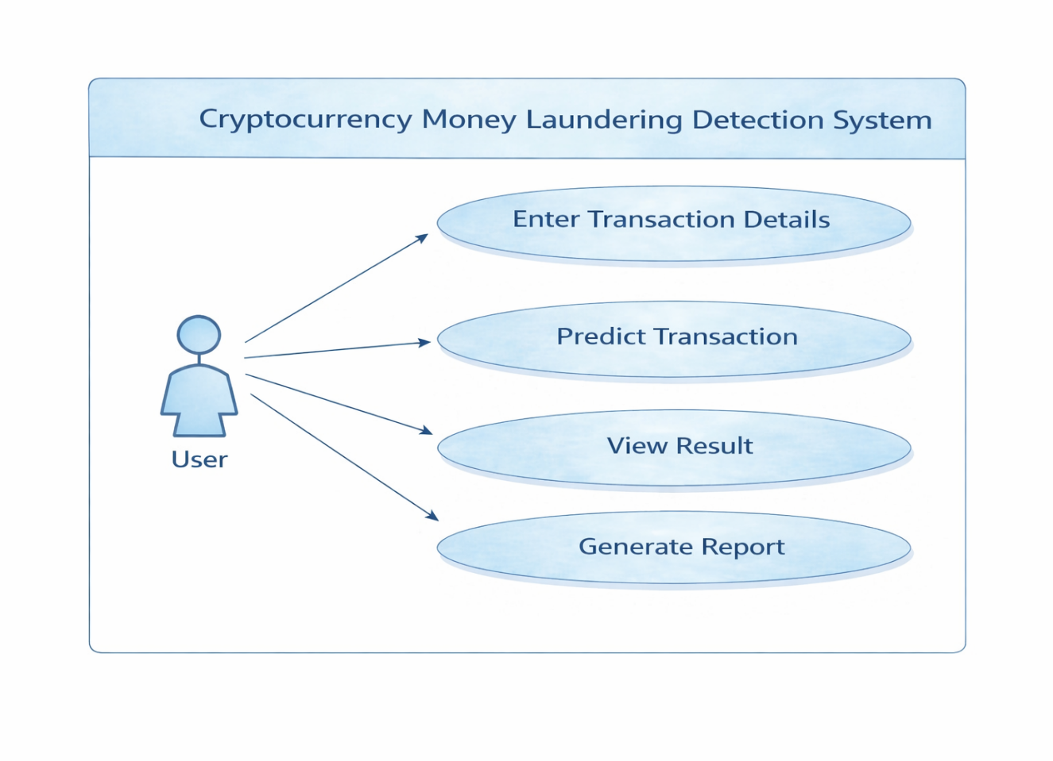
USECASE DIAGRAM

Slide 20
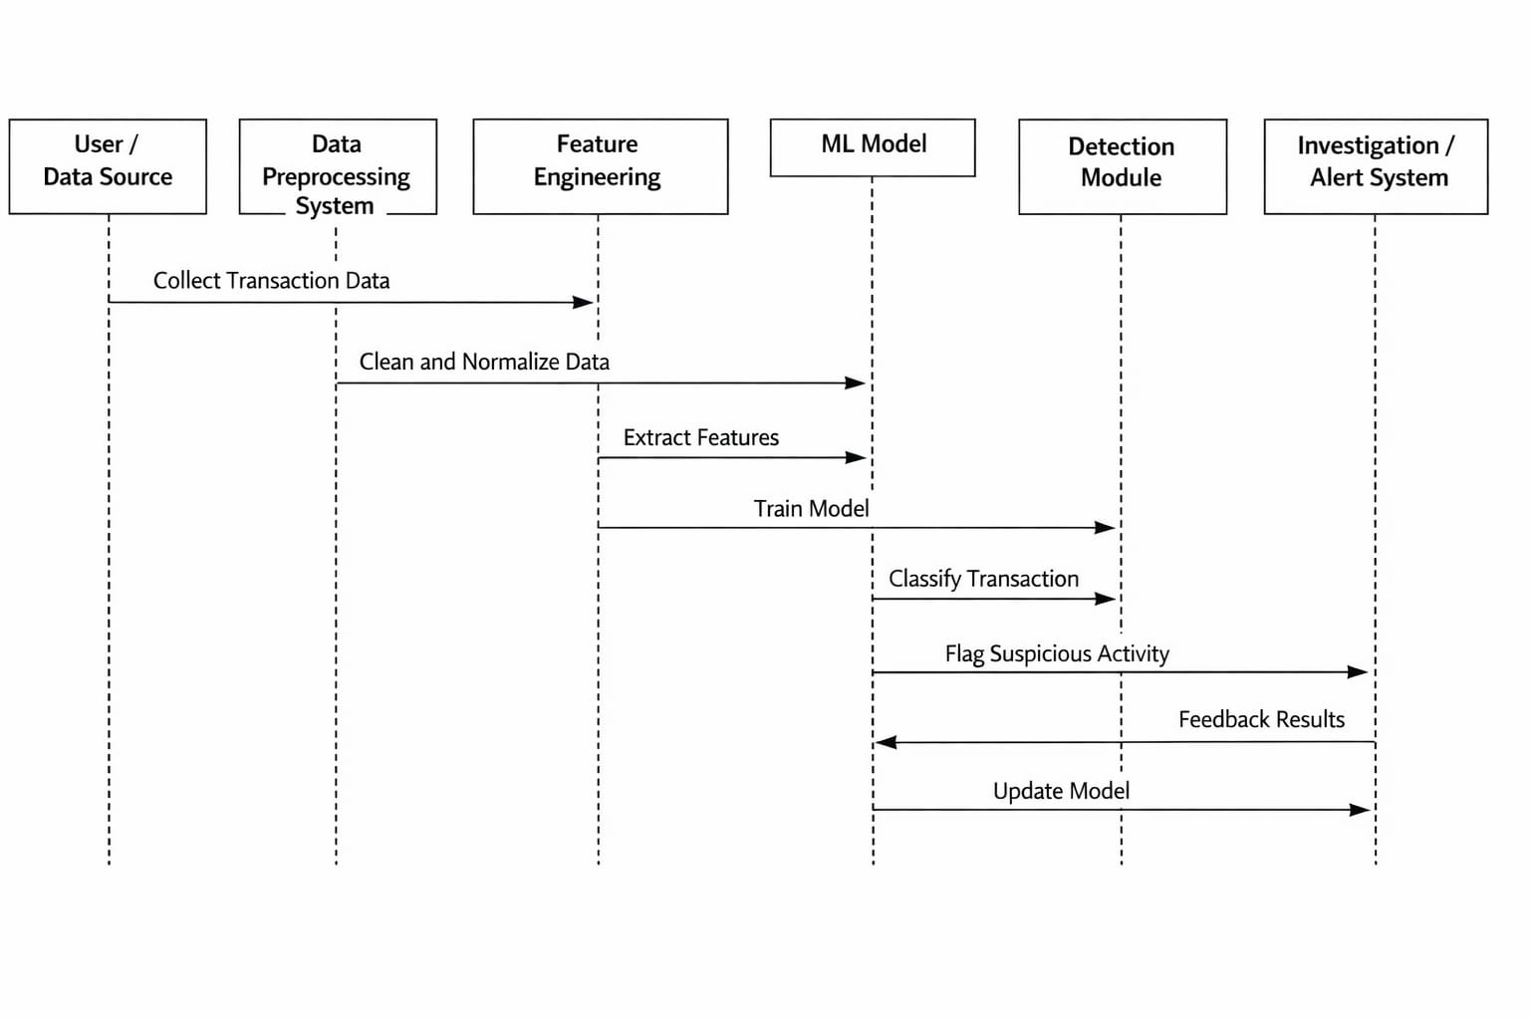
SEQUENCE DIAGRAM

Slide 21
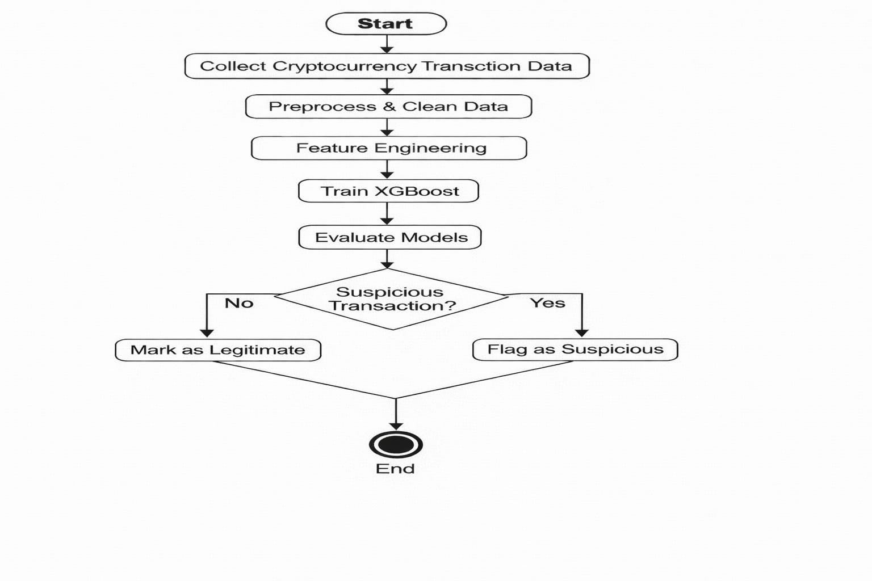
ACTIVITY DIAGRAM

Slide 22
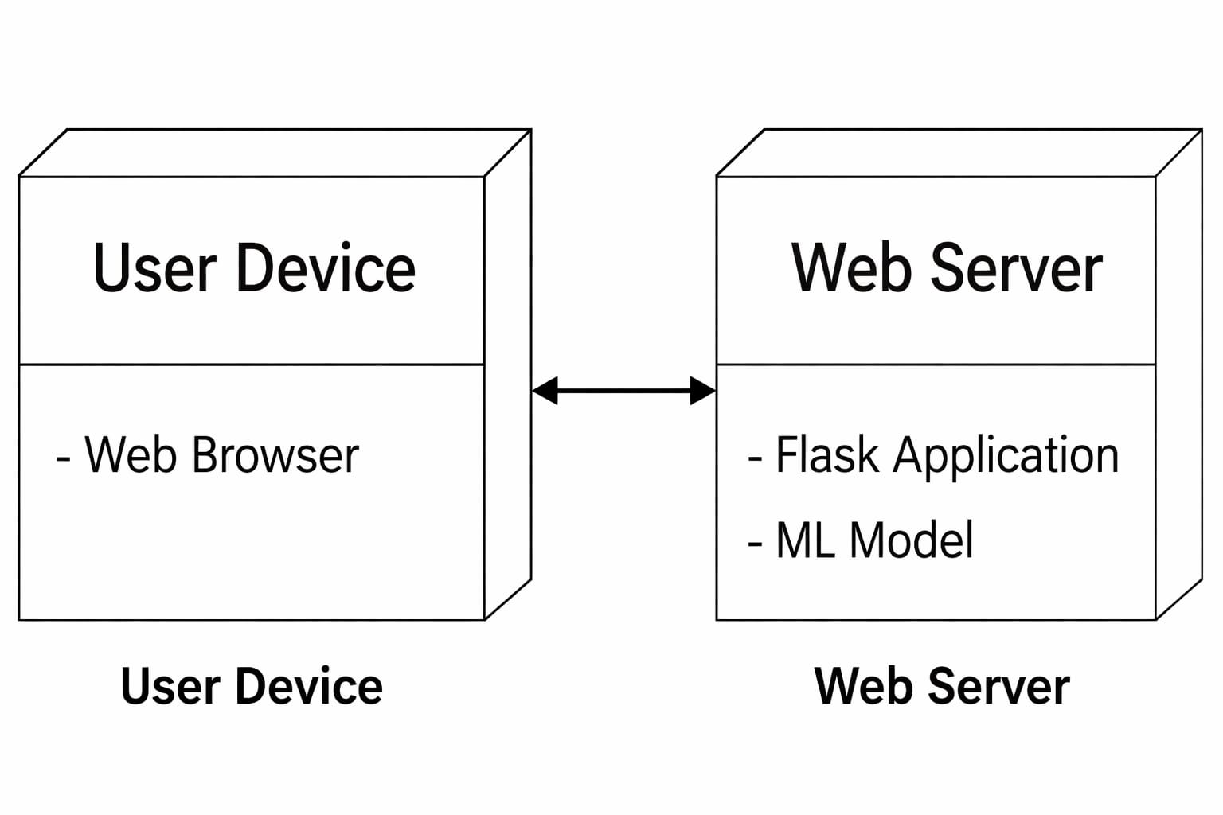
DEPLOYMENT DIAGRAM

Slide 23
TESTING TECHNIQUES
UNIT TESTING
Unit testing focuses on verifying the smallest components of a system individually. In the Cryptocurrency Money Laundering Detection System, modules like data collection, preprocessing, feature extraction, model training, and transaction detection are tested separately. Each function is checked with different inputs to ensure correct outputs. This helps identify errors early and ensures each module works properly, improving overall system reliability.

Slide 24
INTEGRATION TESTING
Integration testing ensures that different modules of the system work together smoothly. In this system, it verifies the connection between data collection, preprocessing, feature extraction, model training, and transaction detection. It checks whether data flows correctly between modules and is properly used at each stage. It also ensures that prediction results are accurately generated and displayed or stored. This helps identify issues related to module interaction, interfaces, and overall system functionality.

Slide 25
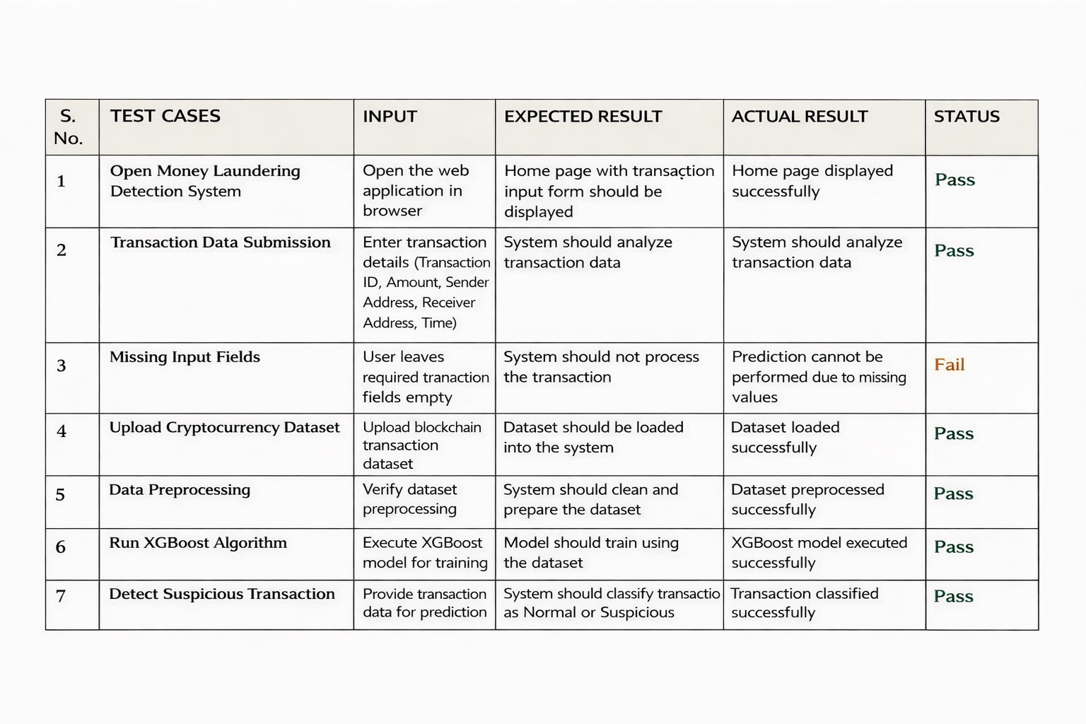
TEST CASES

Slide 26
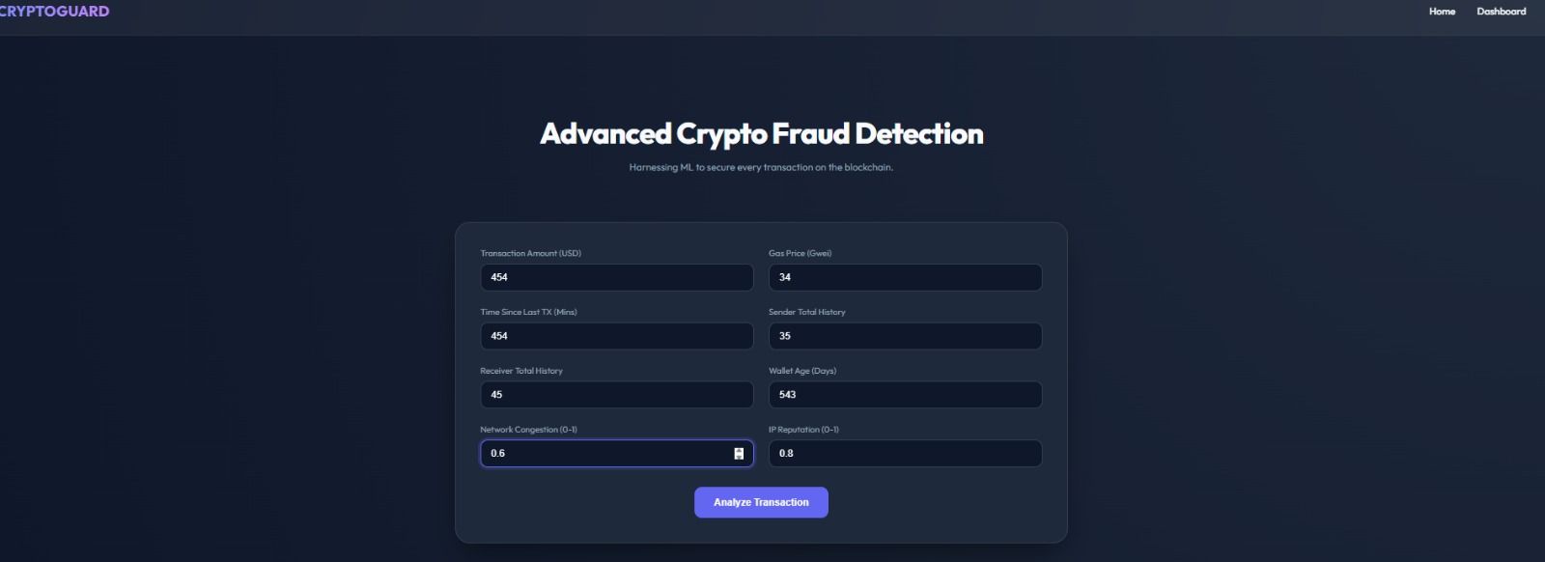
OUTPUT SCREENSHOTS

Slide 27
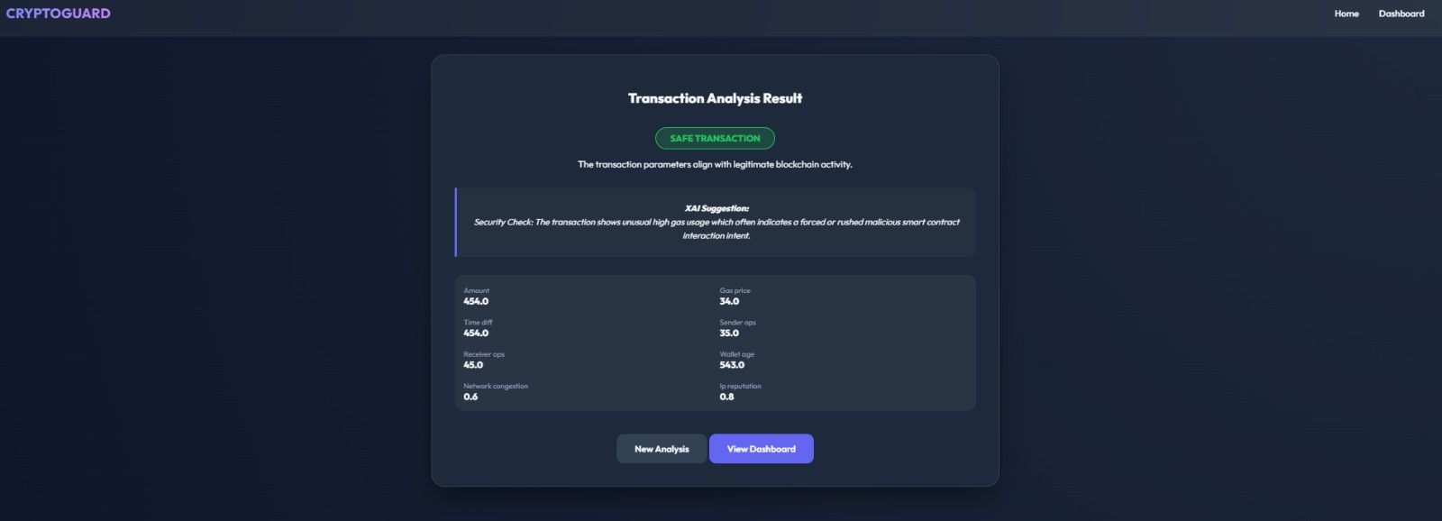

Slide 28
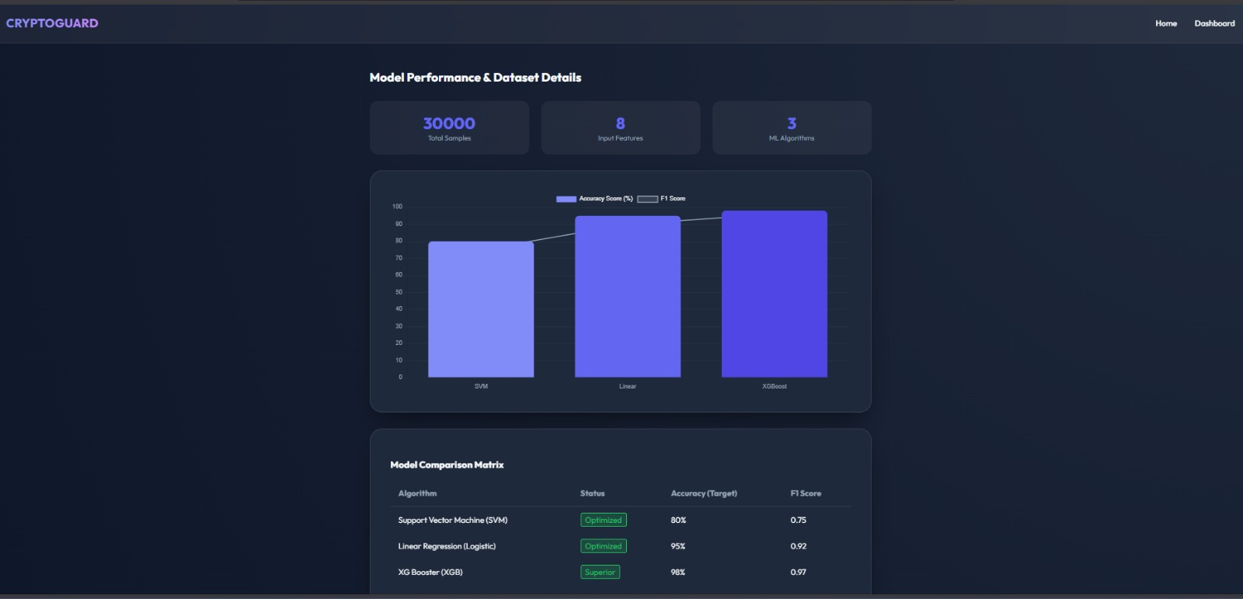

Slide 29
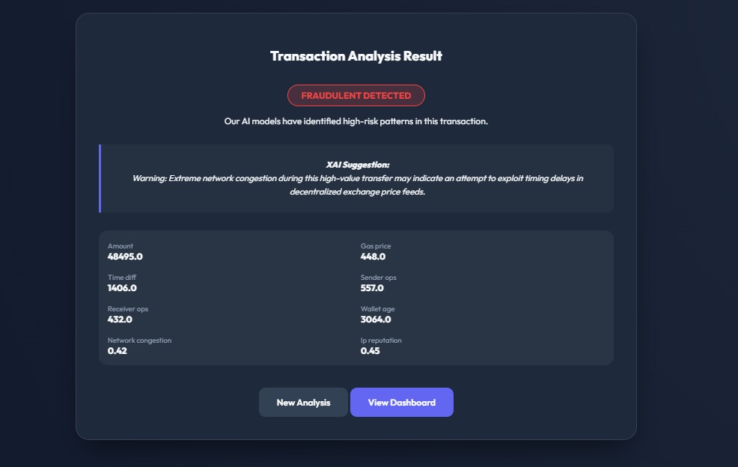

Slide 30
CONCLUSION
The rapid growth of cryptocurrencies has improved digital transactions by making them fast and decentralized. However, the pseudo-anonymous nature of the CryptoCurrency transaction data also creates opportunities for illegal activities like money laundering.
This project uses machine learning techniques such as Support Vector Machine, Linear Regression, and XGBoost to detect suspicious transactions. The system analyzes features like transaction amount, wallet addresses, and transaction frequency.
In conclusion, the project shows that machine learning can effectively detect money laundering and improve monitoring of cryptocurrency transactions.

Slide 31
FUTURE ENHANCEMENT
Real-time detection of illegal crypto transactions.
Support for other cryptocurrencies like Ethereum and Litecoin.
Use of advanced deep learning techniques for better accuracy.
Integration with banks and crypto exchanges for automatic alerts.
Better handling of large-scale crypto data.
Addition of privacy-preserving techniques for secure monitoring.

Slide 32
THANKYOU!

